Slide 1
Social Psychology (Part 2)

Slide 2

RECALL Social Cognition
how people use their cognitive processes (such as attention, perception, memory etc.) in their interactions in the social world

Slide 3
Person Perception
Perception
Forming meaningful interpretations of sensed stimuli
Object of interest in social psychology is the person
Impression Formation
What info do we use when making judgments?
Perceptual cues about appearance
Behaviour

Slide 4
Schemas
Schema
“general knowledge structures” formed based on our experiences
Networks of knowledge that guide
Attention, what we encode and store in memory, interpretations (etc.)
Social schemas: General knowledge structure in long-term memory, that relates to social experiences or people

Slide 5
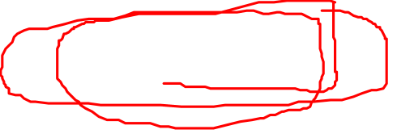
Stereotypes
Collection of beliefs and impressions held about a group and its members
Group schemas
E.g., Racial, gender, sexuality, age (etc.)stereotypes
Lead us to expect certain kinds of behaviour from members of certain groups
We then make judgments of individual people based on these expectations

Slide 6
The problem with stereotypes
Distorted judgments?
Automatic stereotype activation
Especially if recently exposed to behaviour that fits with the stereotype
Stereotypes are not always distorted, but…
They become problematic when
We over-generalize
They increase prejudice and discrimination
We don’t modify them (link to important term Confirmation Bias)

Slide 7
Confirmation bias
found in section on “Prejudice and Oppression” in your e-text
tendency to search for information that matches your pre-existing beliefs
We also have a tendency to discount information that does not fit with our pre-existing beliefs

Slide 8
Self-fulfilling beliefs
Our perceptions and beliefs can influence the social realities around us
Sometimes when we have heard something negative about another, we might act in a way that disconfirms this idea …BUT ….

Slide 9
The Self-fulfilling Prophecy Effect
Most of the time, this is not the case!
When our expectations about the actions of another person actually are borne out
Stereotype activation leads us to have certain expectations → person behaves in expected way
Stereotype threat is one mechanism that creates the self-fulfilling prophecy effect.

Slide 10
Video: Dr. Russell McClain
What is Stereotype Threat?
Give two examples from the clip of activation of stereotype threat.
Think about how stereotype threat may play a role in interactions between people of colour and law enforcement.
Growth mindset – what is it?

Slide 11
Video re: Stereotype Threat
https://www.youtube.com/watch?v=yiZQaE0q9BY

Slide 12
Two other important biases…
In-group bias = we “favour” those within our group compared to those out of our group
Out-group homogeneity = tendency to view people outside of our group as all being similar

Slide 13
Ultimate attribution error
Recall FAE
UAE = we use dispositional explanations when judging ‘negative’ behaviour of an entire group of people
What are some ways that this can show up?

Slide 14
Combatting Prejudice
Robber’s Cave study (Sherif, 1961)
Children assigned to different teams “Rattlers” and “Eagles”
lead to strong in-group biases, negative behaviours toward other group
encouraging people to work towards common goals & higher purpose reduced outgroup negativity
These types of interactions can decrease racial prejudice

Slide 15
Attitudes
Belief – “conclusion based on factual evidence” (Lilienfeld et al., 2020, p. 490)
Attitude -- “belief with emotional component” (Lilienfeld et al., 2020, p. 490)
An attitude is evaluative (Stevens, 2020)

Slide 16
Where do attitudes come from?
Learned predispositions
Experiences (positive or negative) are the main factors that affect the formation of particular attitudes
Recognition heuristic
More likely to believe in something we’ve heard of a lot
Bandwagon fallacy: believing something is true because many people believe it!

Slide 17
How do attitudes change?
Mere thought effect
thinking about something can induce more thoughts that fit with existing attitudes…
These thoughts make the attitude more extreme (polarized)

Slide 18
Dual process theory of Attitude Change
The type of message (and our processing of it) influences likelihood of attitude change
Peripheral processing (superficial)
Central processing (elaboration)
Which ‘route’ is taken depends on the relevance of the message to us

Slide 19
Cognitive Dissonance: A theory of how attitudes can change
Premise: we are motivated to maintain consistency in our thoughts, feelings, & behaviours
When conflicts exist among a, b, c
We experience dissonance… an uncomfortable feeling of tension due to the conflict
To reduce the unpleasant experience of dissonance …
We change our behaviour
Or we change our original beliefs…

Slide 20
Cognitive Dissonance
CD is akin to a motivational drive.
When behaviour is very discrepant from your beliefs …
Easier to change beliefs
People resolve dissonance in different ways

Slide 21
Festinger & Carlsmith (1959)
Participants did a boring task (putting plastic spools into a tray, take them out, put them back again)
Two groups: they were asked to lie
some got paid $1; some got paid $20 → to tell the next person that the task was “very enjoyable”
The manipulation is the amount of money
Should act as proxy for external justification
Participants debriefed after, we asked about their true feelings toward the task

Slide 22
Festinger & Carlsmith (1959)
Results
$1 group reported higher enjoyment of the boring task compared to the $20 group
They had no external justification for saying the task was enjoyable/lying
Should have experienced strong dissonance
Conclusion: discrepancy between lying about task and what it actually was like caused an attitude change

Slide 23
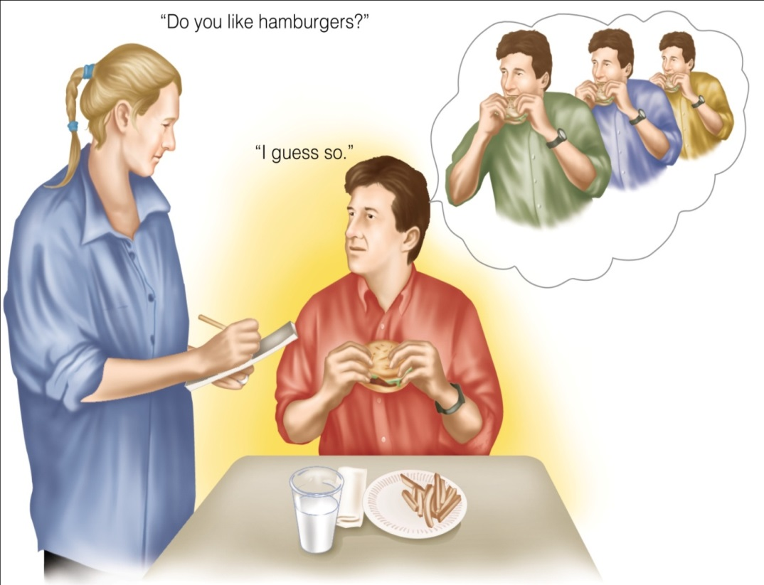
Alternative explanation:
Self-Perception Theory
We use observations of own behaviour as a basis for inferring our own beliefs

Slide 24
Alternative explanations
Bem’s Self-perception theory
We infer our beliefs based on our behaviour
Maybe participants looked to their behaviour and then inferred their attitude toward the task
Impression Management theory:
We don’t actually change our attitudes, but report that we have for consistency

Slide 25
Implicit Attitudes
Can be problematic in this area of research
People may not always be aware of their true attitudes
Implicit Association Test (IAT) was developed
Response time to associations are measured (e.g. dog-pleasant)
Typically, we respond faster to associations that reflect our true, implicit attitudes

Slide 26
Prosocial Behaviour: Altruism
Altruism: helping others for “unselfish reasons”
Note that there is a subtle difference between the general category ‘prosocial behaviour’ and altruism
Factors involved in helping
Modeling
Awareness of bystander non-intervention
Positive emotions
Our attributions about the person who may need assistance

Slide 27
Bystander Non-intervention (see section on Aggression in your e-text)
AKA ‘the bystander effect’
Many cognitive steps involved in our decision to help
The presence of lots of other people can be a hindrance to our helping behaviour
Is this an emergency?
Everyone else is just walking by… Am I the only one who perceives it as an emergency? (Pluralistic ignorance)
If we decide it is a problem and the person should be assisted…
Do we feel personally responsible to help?
Diffusion of responsibility: the more people that are around, the less personally responsible we tend to feel for helping out.

Slide 28
Thus there are different reasons for why people may not help
In addition, people may be personally distressed by what they are witnessing
Getting caught up in our own personally distress (self-focus), if too much, is inversely related to empathy (i.e., other-focus)
We may become afraid of negative consequences of helping
Like getting hurt ourselves
Offending the people we think needs assistance
Note that genuinely altruistic behaviour is not going to be constrained by these concerns…

Slide 29
The end

